Slide 1
Introduction to Bitcoin

Slide 2
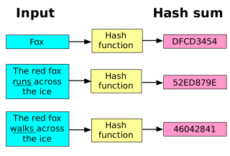
Fundamentals of Cryptography
Cryptographic Hash Functions
Input message(Varaible size)
Output bits(Fixed)

Slide 3
Hash property 1: Collision-free
Nobody can find x and y such that x != y and H(x)=H(y)
Application: Hash as message digest

Slide 4
Hash property 2: Hiding
We want something like this:
Given H(x), it is infeasible to find x.
Hiding property:
A hash function H is hiding,If r is chosen from a probability distribution that has high min-entropy, then given H(r | x), it is infeasible to find x.

Slide 5
Application: Commitment
Want to “seal a value in an envelope”, and
“open the envelope” later.
Commit to a value, reveal it later.

Slide 6
With this additional property we can now assure that:
1.Given the commitment and the envelope on the table, someone just looking at it can't figure out what the message is (pre-image resistance)
2. when you commit to what's in the envelope, you can't change your mind later (collision resistance)

Slide 7
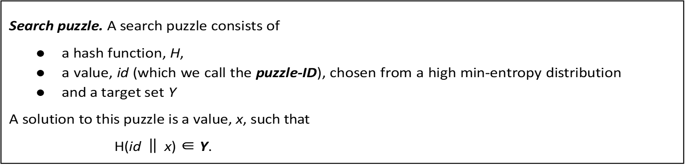
Hash property 3:Puzzle friendliness property
Given an output value y (hash of an element x), it must be really difficult to find another element x′ that hashes to y.
Application: Search puzzle:

Slide 8
By applying the "puzzle friendliness" property, search puzzles can ensure that solutions are unique, difficult to find, and verifiable, making them more engaging and challenging for solvers.
In summary, hash functions:
Hide sensitive information (passwords)
Verify authenticity and integrity (digital signatures, data integrity)
- Ensure uniqueness and integrity (collision-free property)

Slide 9
How SHA-256 works?
Step 1: Padding
Step2 : Append length
Step3 :Divide the input into 512-bit blocks
Step4: Initialize chaining varaibles
A := 0x6a09e667
B := 0xbb67ae85
C := 0x3c6ef372
D := 0xa54ff53a
E := 0x510e527f
F := 0x9b05688c
G := 0x1f83d9ab
H := 0x5be0cd19

Slide 10
Step 5: Process blocks
5.1 : copy the chaining variables into eight corresponding variables a,b,c , d ,e,f,g and h
5.2 :Divide the current 512 bit block into 16 sub-blocks(size-32bits)
5.3: SHA-256 has 64 rounds.
Conceptual process within a round
Other constants(t)
16 sub-blocks
One round
a | b | c | d | e | f | g |h

Slide 11
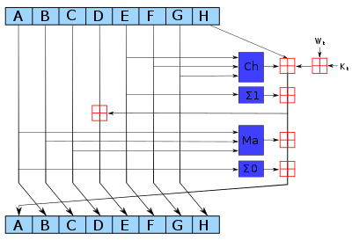
Ch ⁡ ( E , F , G ) = ( E ∧ F ) ⊕ ( ¬ E ∧ G )
Ma ⁡ ( A , B , C ) = ( A ∧ B ) ⊕ ( A ∧ C ) ⊕ ( B ∧ C )
Σ 0 ( A ) = ( A ⋙ 2 ) ⊕ ( A ⋙ 13 ) ⊕ ( A ⋙ 22 )
Σ 1 ( E ) = ( E ⋙ 6 ) ⊕ ( E ⋙ 11 ) ⊕ ( E ⋙ 25 )
addition modulo 2³² for SHA-256

Slide 12
k[0..63] :=
0x428a2f98, 0x71374491, 0xb5c0fbcf, 0xe9b5dba5, 0x3956c25b, 0x59f111f1, 0x923f82a4, 0xab1c5ed5,
0xd807aa98, 0x12835b01, 0x243185be, 0x550c7dc3, 0x72be5d74, 0x80deb1fe, 0x9bdc06a7, 0xc19bf174,
0xe49b69c1, 0xefbe4786, 0x0fc19dc6, 0x240ca1cc, 0x2de92c6f, 0x4a7484aa, 0x5cb0a9dc, 0x76f988da,
0x983e5152, 0xa831c66d, 0xb00327c8, 0xbf597fc7, 0xc6e00bf3, 0xd5a79147, 0x06ca6351, 0x14292967,
0x27b70a85, 0x2e1b2138, 0x4d2c6dfc, 0x53380d13, 0x650a7354, 0x766a0abb, 0x81c2c92e, 0x92722c85,
0xa2bfe8a1, 0xa81a664b, 0xc24b8b70, 0xc76c51a3, 0xd192e819, 0xd6990624, 0xf40e3585, 0x106aa070,
0x19a4c116, 0x1e376c08, 0x2748774c, 0x34b0bcb5, 0x391c0cb3, 0x4ed8aa4a, 0x5b9cca4f, 0x682e6ff3,
0x748f82ee, 0x78a5636f, 0x84c87814, 0x8cc70208, 0x90befffa, 0xa4506ceb, 0xbef9a3f7, 0xc67178f2
for i from W[16 to 63]
s0 := (w[i-15] rightrotate 7) xor (w[i-15] rightrotate 18) xor (w[i-15] rightshift 3)
s1 := (w[i-2] rightrotate 17) xor (w[i-2] rightrotate 19) xor (w[i-2] rightshift 10)
w[i] := w[i-16] + s0 + w[i-7] + s1

Slide 13
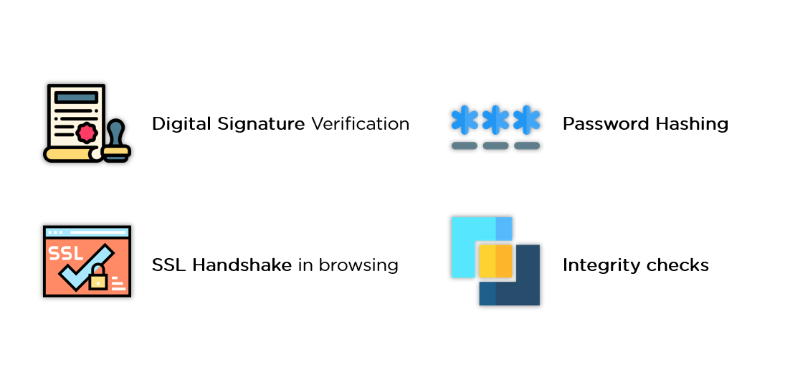
Applications
OutputOutput
Input
Vellore Institute of Technology
Output
a6b745a20421874af6467d15757f36c85e52c366a71a43497e7b03b4c3c713d4
Input
Vellore Institute of Technologi
Output
bd9106302fd0db7745a50eb06def324ab8702b465ffd72cc04af63fa65ff5857

Slide 14
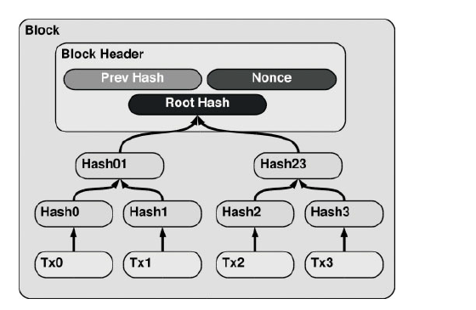
Merkle tree:

Slide 15
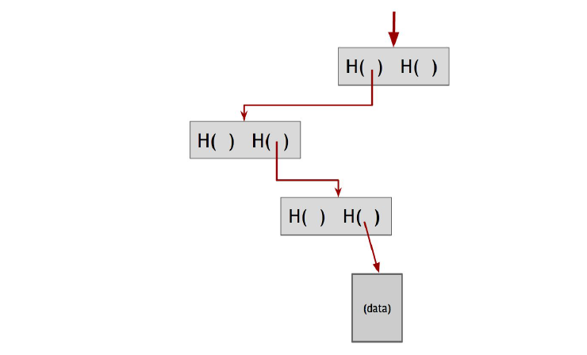
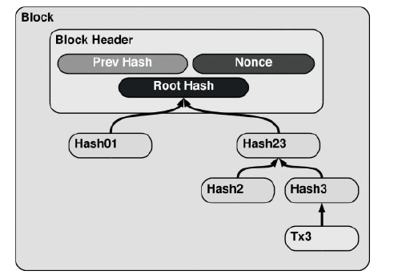
Data Verification
A verifier to:-
Recompute the hashes up the tree using the provided branch-
Compare the recomputed root hash with the known root hash of the Merkle tree
If the recomputed root hash matches the known root hash, it proves that the element is indeed part of the original set, without revealing any other elements in the set.

Slide 16
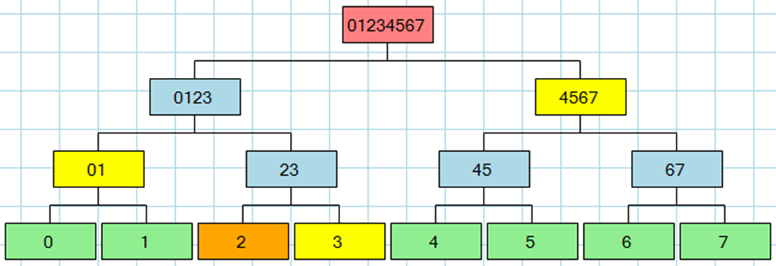
Data Verification (Audit Proof) Work
Let's say you are the owner of the transaction "2" in the below diagram. You also have, from a trusted authority, the root hash, which is "01234567". You ask the server to prove to you that your transaction "2" is in the tree. What the server returns to you are the hashes "3", "01", "4567" as illustrated here:

Slide 17
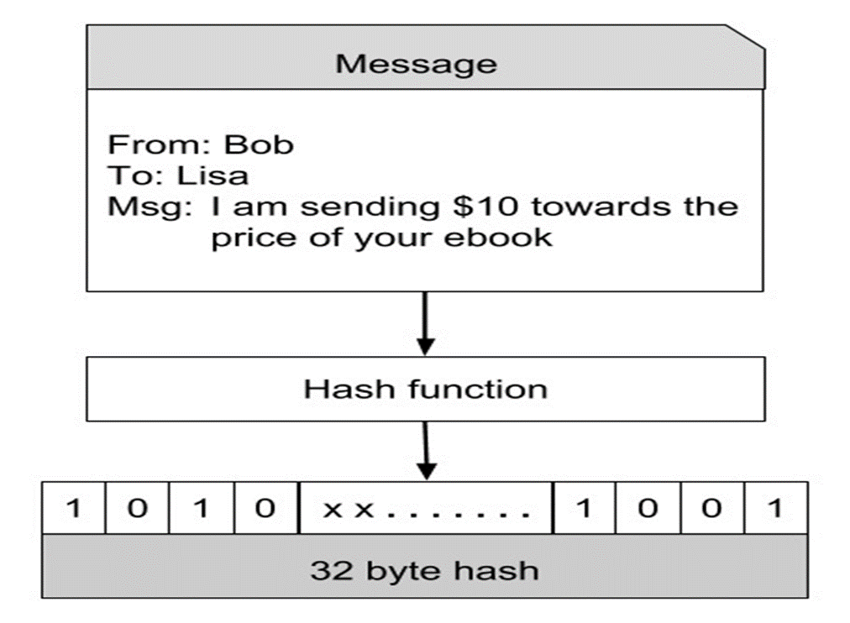
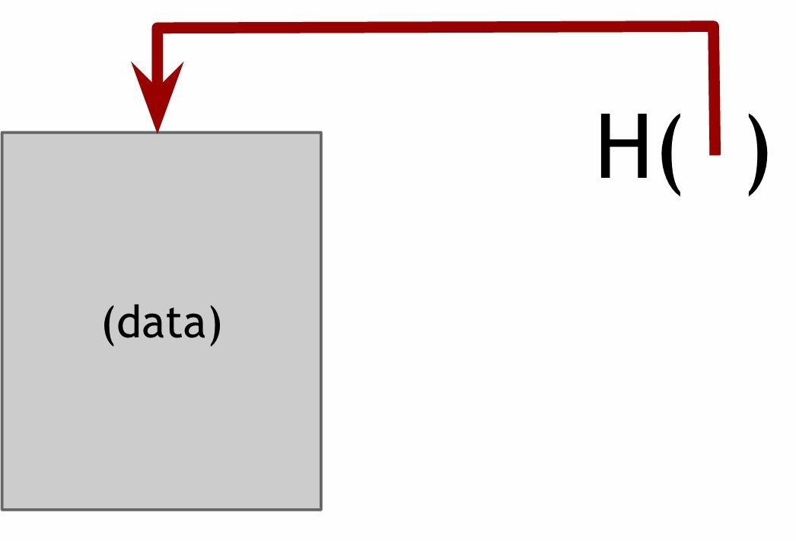
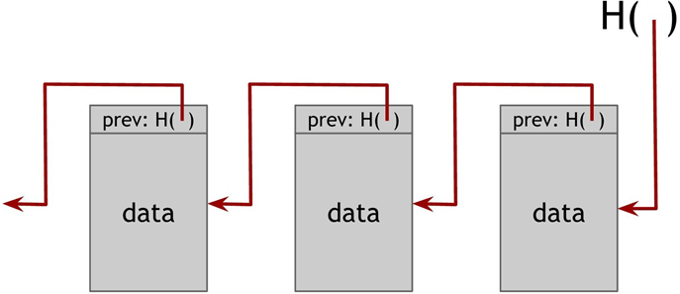
Hash pointer
A hash pointer tells us where something is and what it's value was.

Slide 18
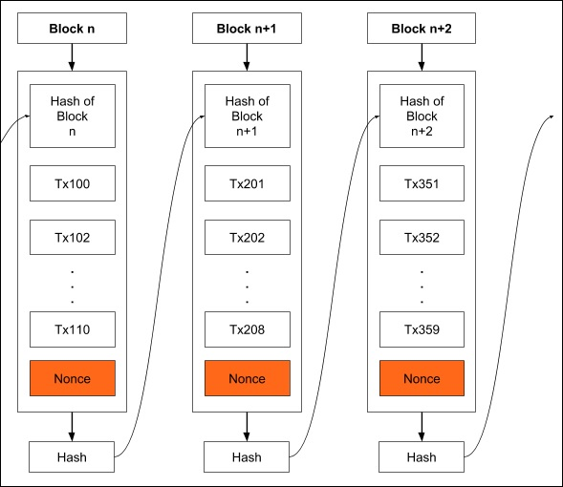
The generated hash would look like 000010101010xxx

Slide 19
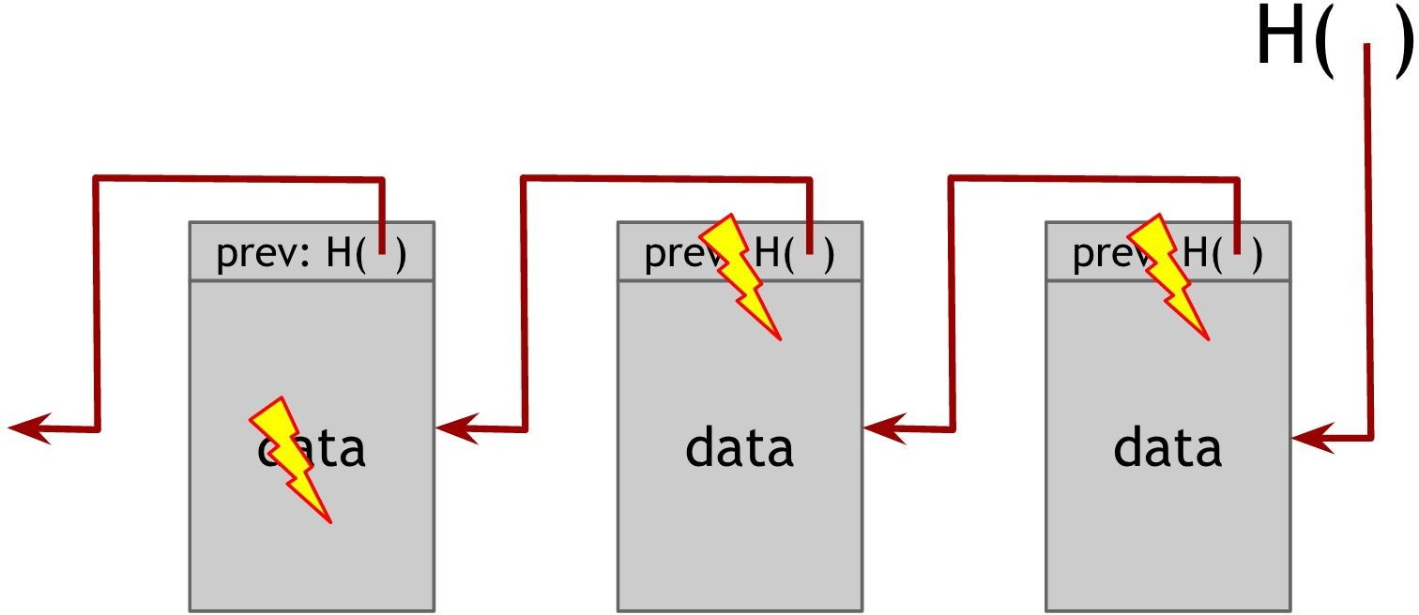
Tamper evidence
If an adversary modifies data anywhere in the block chain, it will result in the hash pointer in the following block being incorrect. If we store the head of the list, then even if the adversary modifies all of the pointers to be consistent with the modified data, the head pointer will be incorrect, and we will detect the tampering.

Slide 20
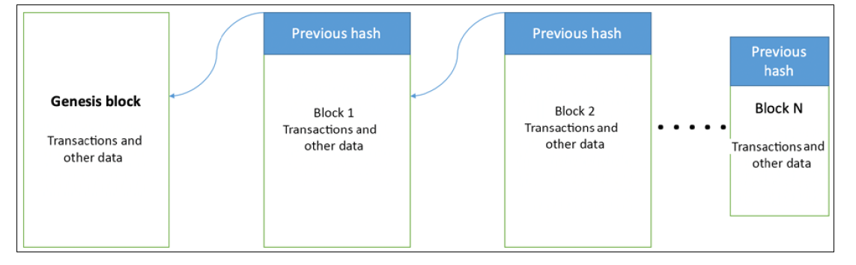
Fig:Generic structure of a block chain

Slide 21
So Merkle trees have various advantages:
The tree holds many items but we just need to remember the one root hash (only 256-bits)
We can verify membership in a Merkle tree in logarithmic time and logarithmic space

Slide 22
Digital Signatures
only the owner can make the signature, but everyone seeing it can verify it's validity

Slide 23
Digital Signatures
I agree
Efcc61c1c03db8d8ea8569545c073c814a0ed755
My place of birth is at Gwalior.
fe1188eecd44ee23e13c4b6655edc8cd5cdb6f25
I am 62 years old.
0e6d7d56c4520756f59235b6ae981cdb5f9820a0
I am an Engineer.
ea0ae29b3b2c20fc018aaca45c3746a057b893e7
I am a Engineer.
01f1d8abd9c2e6130870842055d97d315dff1ea3
These are digital signatures of same person on different documents
Digital Signatures are numbers
They are document content dependent

Slide 24
.
Signature scheme
These three operations constitute a signature scheme:
Generate a pair of keys: sk= secret signing key, and pk = public verification key of length in bit equal to keysize. So we will need an operation (sk,pk):=generateKeys(keysize). sk will be the key to make the signature and pk will be the key that let other subjects verify the signature.
Sign documents: takes the secret key sk and a message m and returns the message signed sig. So we will need an operation sig:=sign(sk,message)
Signature verification: takes the public key pk, the message m and the supposed signature and returns yes or no, whether the signature is valid or not
These three operations constitute a signature scheme. The first two can be randomized algorithms, while the verification will always be deterministic. Infact, generateKeys must generate different keys for different people.

Slide 25
The following two properties hold:
Valid Signature must verify
verify(pk, message .sign(sk,message )) == true
Signatures are existentially unforgeable It must be impossible to forge signatures. An adversary who knows my public key and verifies my signatures on some messages, can't forge my signature on some other messages.

Slide 26
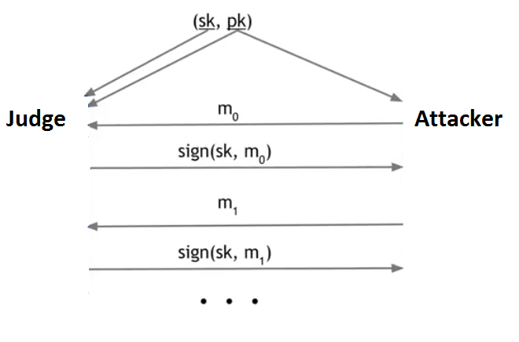

Signatures are existentially unforgeable
after that, the attacker picks a new message M and tries to forge a signature.
the judge will run the verification algorithm to check whether it verifies or not.
The signature scheme is unforgeable if the attacker has only a negligible chance of successfully forging a message no matter what algorithm the attacker is using.

Slide 27
Signed Messages
Calculated
Hash
Message
Message
+
signature
Sent thru’ Internet
Message
+
Signature
if
OK
Signatures
verified
COMPARE
Hash
Signed
Message
SIGN hash
With Sender’s
Private key
Hash
Decrypt
Signature
With Sender’s
Public Key
Sender
Receiver

Slide 28
ECDSA
Bitcoin uses a particular digital signature scheme called ECDSA. It's an Elliptic Curve Digital Signature Algorithm
We won't go into all the details of how ECDSA works, since it relies on some extremely hairy math.
ECDSA has good randomness, and this in very important with Elliptic Curves. Since, if you use bad randomness in general in generating a key, then it is maybe not secure. In addition for ECDSA, even if the key is perfectly secure, and the bad randomness only regards the signature generation, this will also lead to private key discovery.

Slide 29
Elliptic Curve Cryptography(ECC)
ECC was introduced by Victor Miller and Neal Koblitz in 1985 in 1985
ECC provides same level of security with smaller key sizes.
A 256 bit ECC public key provides comparable security to a 3072 bit RSA public key. The primary advantage of using ECC based cryptography is reduced key size hence speed.
Elliptic curves have nothing to do with ellipses. Ellipses are formed by quadratic curves.(x² ).Elliptic curves are always cubic (x³ )
Block chain implementations such as Bitcoin or Ethereum uses the Elliptic curves to generate public and private keys
y² = x³ + 2x + 3 (mod 5)

Slide 30
parameters | Elliptic curve key length | RSA key length
secp192kl | 192 | 1536
secp224kl | 224 | 2048
secp256kl | 256 | 3072
secp384kl | 384 | 7680
secp512kl | 512 | 15360
Bitcoin and ethereum both uses same secp256kl elliptic curve domain parameters

Slide 31
Key generation:
1.Alice chooses an elliptic curve E_{p} (a,b) with p is a prime number
2.Alice chooses another prime number q to be used in the calculation
3.Alice chooses the private key d,an integer
4.Alic chooses e1(….) point on the curve
5.Alice calculates e2(…)=d × e1(….) ,another point on the curve
6.Alice ‘s public key is (a,b,p,q,e1,e2);private key is d

Slide 32
Signature generation
Alice chooses a secret random number r, between 1 and q-1
Alice selects a third point on the curve.P(u,v)=r × e1(…)
Alice uses the first coordinates of P(u,v) to calculate the first signature S1.This means S1=u mod p
Alice chooses the hash of the message,her private key,and the secret random number r, and the S1 to calculate the signature S2=(h(M) + d × S1)r⁻¹ mod q
Alice sends M,S1 and S2

Slide 33
Signature Verification:
Bob uses M,S1 and S2 to create two intermediate results ,A and B
A=h(M)S2⁻¹ mod q and B= S2⁻¹ S1 mod q
Bob then reconstructs the third point T(x,y)=A × e1(….) + B × e2(….)
2. Bob uses the first coordinator of T(x,y) to verify the message .
if x=S1 mod q , signature is verified
otherwise,it is rejected.

Slide 34
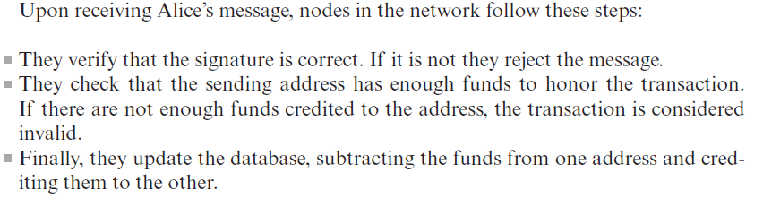
Addresses and Transactions:
Bitcoin identifies the users by large strings of numbers and letters like:

Slide 35
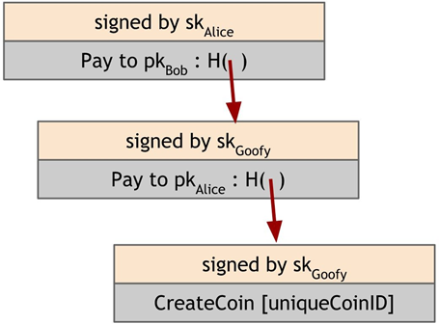
Simple Cryptocurrency:
Goofy Coin
Scrooge Coin
- Goofy Coin
It is possible to verify the validity of a coin by simply following the chain and verifying all the signatures

Slide 36
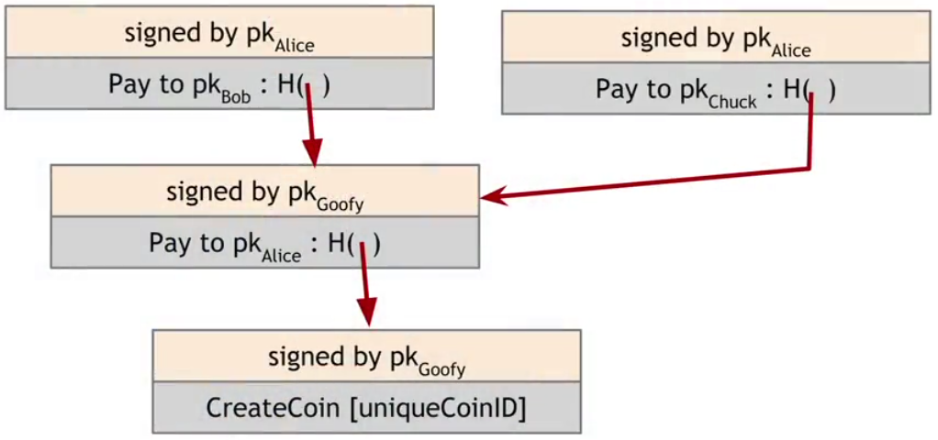
Double spending problem
1.Goofy makes a transaction to pay Alice
2.Alice makes a transaction to pay Bob
3.Then Alice makes another transaction to Chuck, sending the same coin

Slide 37
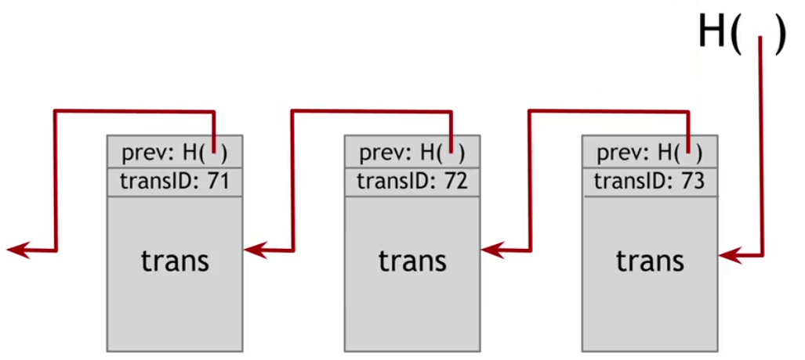
---Scrooge Coin

Slide 38
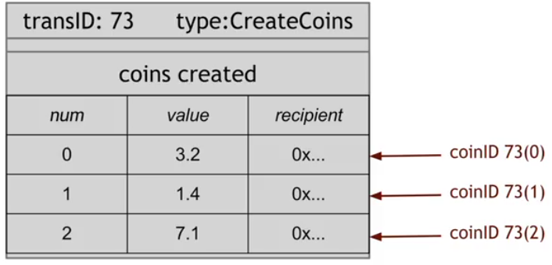
Transactions types
In ScroogeCoin there are two kinds of transactions:
1. CreateCoins transaction:

Slide 39
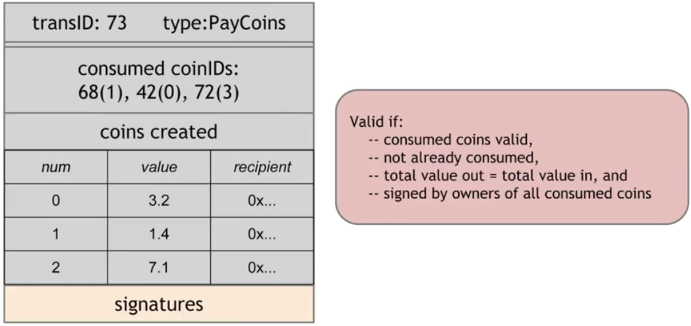
2. PayCoins transaction
2. PayCoins transaction:
This transaction is valid if four conditions are met:
1.the consumed coins are valid: they were really created in previous transactions
2. double-spending check: the consumed coins were not already been spent in previous transactions
3. the total value of the newly created coins is equal to the total value of the destroyed coins
4. all the digital signature of previous owners are valid

Slide 40
This is a simulation of Scrooge Coin: a simple crypto-currency system using python.
The system includes 100 users. A designated entity “Scrooge” publishes an append-only ledger that contains all the history of transactions.
The ledger is a blockchain, where each block contains transactions, its ID, the hash of the block, and a hash pointer to the previous block.
The final hash pointer is digitally signed by Scrooge.
Initially, Scrooge creates 1000 coins and pays each user 10 coins.
This is a simulation of a network of multiple users: a randomized process of making a transaction, making each transaction reach an arbitrary user.
Upon detecting any transaction, scrooge verifies it by making sure the coin really belongs to the owner and it has not been spent before.

Slide 41
If verified, Scrooge adds the transaction to the blockchain. Double spending can only happen before the transaction is published.
A Merkel Tree is implemented which reflects the change in the blockchain when adding a new block to the blockchain.
Each recepient uses the Merkel Tree to make sure that the coins are not spent before by the same sender.
Upon running, each user's data is printed out, followed by the initial blockchain.
Upon adding a block, the new blockchain is printed out.

Slide 42
The Problem with Scoorge:
Scoorge could stop endorsing transactions from some users,denying them service and making their coins unspeakable.
If the Scoorge is greedy ,he could refuse to publish transactions unless they transfer some mandated transaction fee to him.
Scoorge can also of course create as many new coins for himself as he wants.
If Scoorge gets bored of the whole system and stop updating the blockchain completely.
The problem we have here is Centralization: although Scrooge is happy with the system, the users of it might not be. In order to improve on ScroogeCoin is necessary to decentralize the system.

Slide 43
We need to figure out:
How everyone can agree upon a single published blockchain, on which transactions are valid and which transactions actually occurred
how we can assign IDs to things in a decentralized way

Slide 44
Let H be a hash function that is both hiding and Puzzle-friendly. Consider G(Z) = H(Z) || Z_{last} where Z_{last} represents the last bit of Z. Show that G is puzzle friendly but not hiding
2. Alice can use a Merkle tree to commit to a set of elements S = {e₀, . . . , e_{n−1}} so that later she can prove to Bob that some e_{i} is in S using at most [log n] hash values.
Consider how to do the same with a 3-ary tree, where every leaf node has up to 3 children. The hash at every non-leaf node is the hash of the concatenation of the children.
Suppose S = {e₀, . . . , e₈}. How does Alice prove to Bob that e₃ is in the tree?
If S contains n elements, what is the length of the proof that shows that some e_{i} is in S?
How long is the proof if we replace 3 with k > 2?

Slide 45
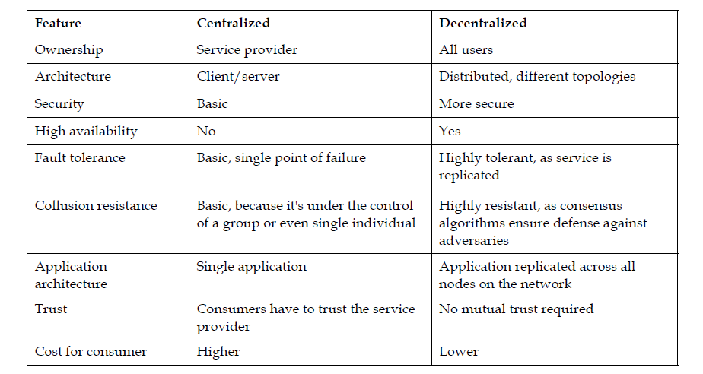
Centralization vs. Decentralization

Slide 46

Example -Solar Energy:
is currently being built is by a decentralized organization called PowerLedger.
By using blockchain technology, developed a system that cuts out of the middleman. Here’s how it works:
Ravi has solar panels on his house and uses the electricity he needs.
Ravi has extra electricity left over, which he plans to sell.
Normally, he would have to sell it back to the electricity company, however, with the help of PowerLedger, he can sell it to someone else directly at a fair market price.
His readings are posted on to the public blockchain, and anybody in the local area can buy the extra electricity from him.
Not only does Ravi get a better price, but so does the buyer.
All of this can be done without the help of a centralized third party.

Slide 47
Advantages:
The fair market price for both the buyer and seller ✓ No need for a third party (who profits off both the buyer and seller) ✓ Buyer pays in cryptocurrency, which is quicker and cheaper than traditional payment methods

